Slide 1
Sustainable Development
4.7
Copyright Bananaomics

Slide 2
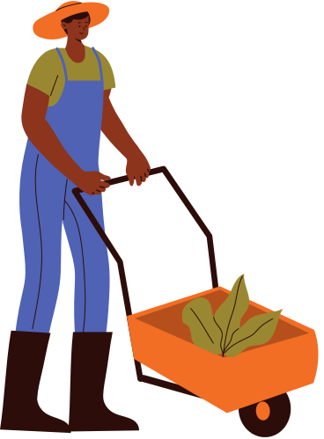
There is a difference between economic growth and development. Discuss with a partner what you think the difference is.
Copyright Bananaomics

Slide 3
Economic Growth vs Development
Economic Growth
Increase in real GDP over time.
Economic Development
A multidimensional concept involving a sustained increase in living standards that implies higher levels of income and thus greater access to goods and services, better education and health, a better environment to live in as well as individual empowerment.
Copyright Bananaomics

Slide 4
Economic Development
Development was formerly measured traditionally using real GDP with the understanding that increases in income lead to development. However, now we understand that access to food, water, shelter, education, and healthcare are more important.
Copyright Bananaomics

Slide 5
Sustainable Development
What is sustainable development?
Refers to the degree to which the current generation is able to meet its needs today but still conserve resources for the sake of future generations.
The United Nations have developed an important guideline for sustainable development called the Sustainable Development Goals (SDGs).
Copyright Bananaomics

Slide 6
Do you know all 17 SDGs?
United Nations
Copyright Bananaomics

Slide 7
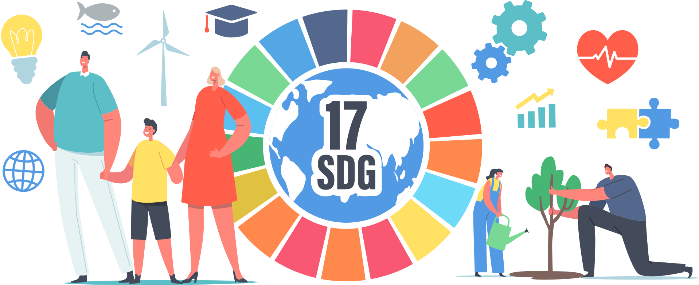
SDG Inquiry
Explore the 17 Sustainable Development goals below.
Attempt to categorize them
Rank your top 10 SDGs by level of importance.
Provide a small 1 paragraph description of why you ranked them the way you did.
Copyright Bananaomics

Slide 8
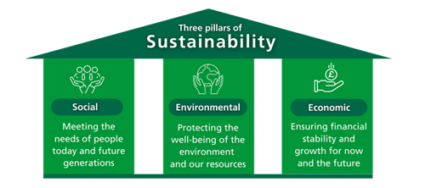

Slide 9
https://www.youtube.com/watch?v=pgNLonYOc9s&t=83s

Slide 10
summarise the 5 Ps which form the basis of the sustainable development goals:

Slide 11
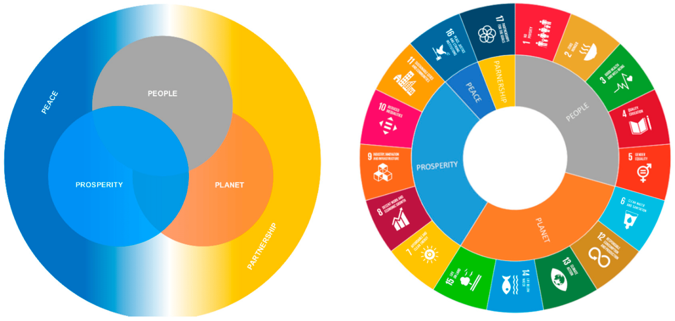

Slide 12
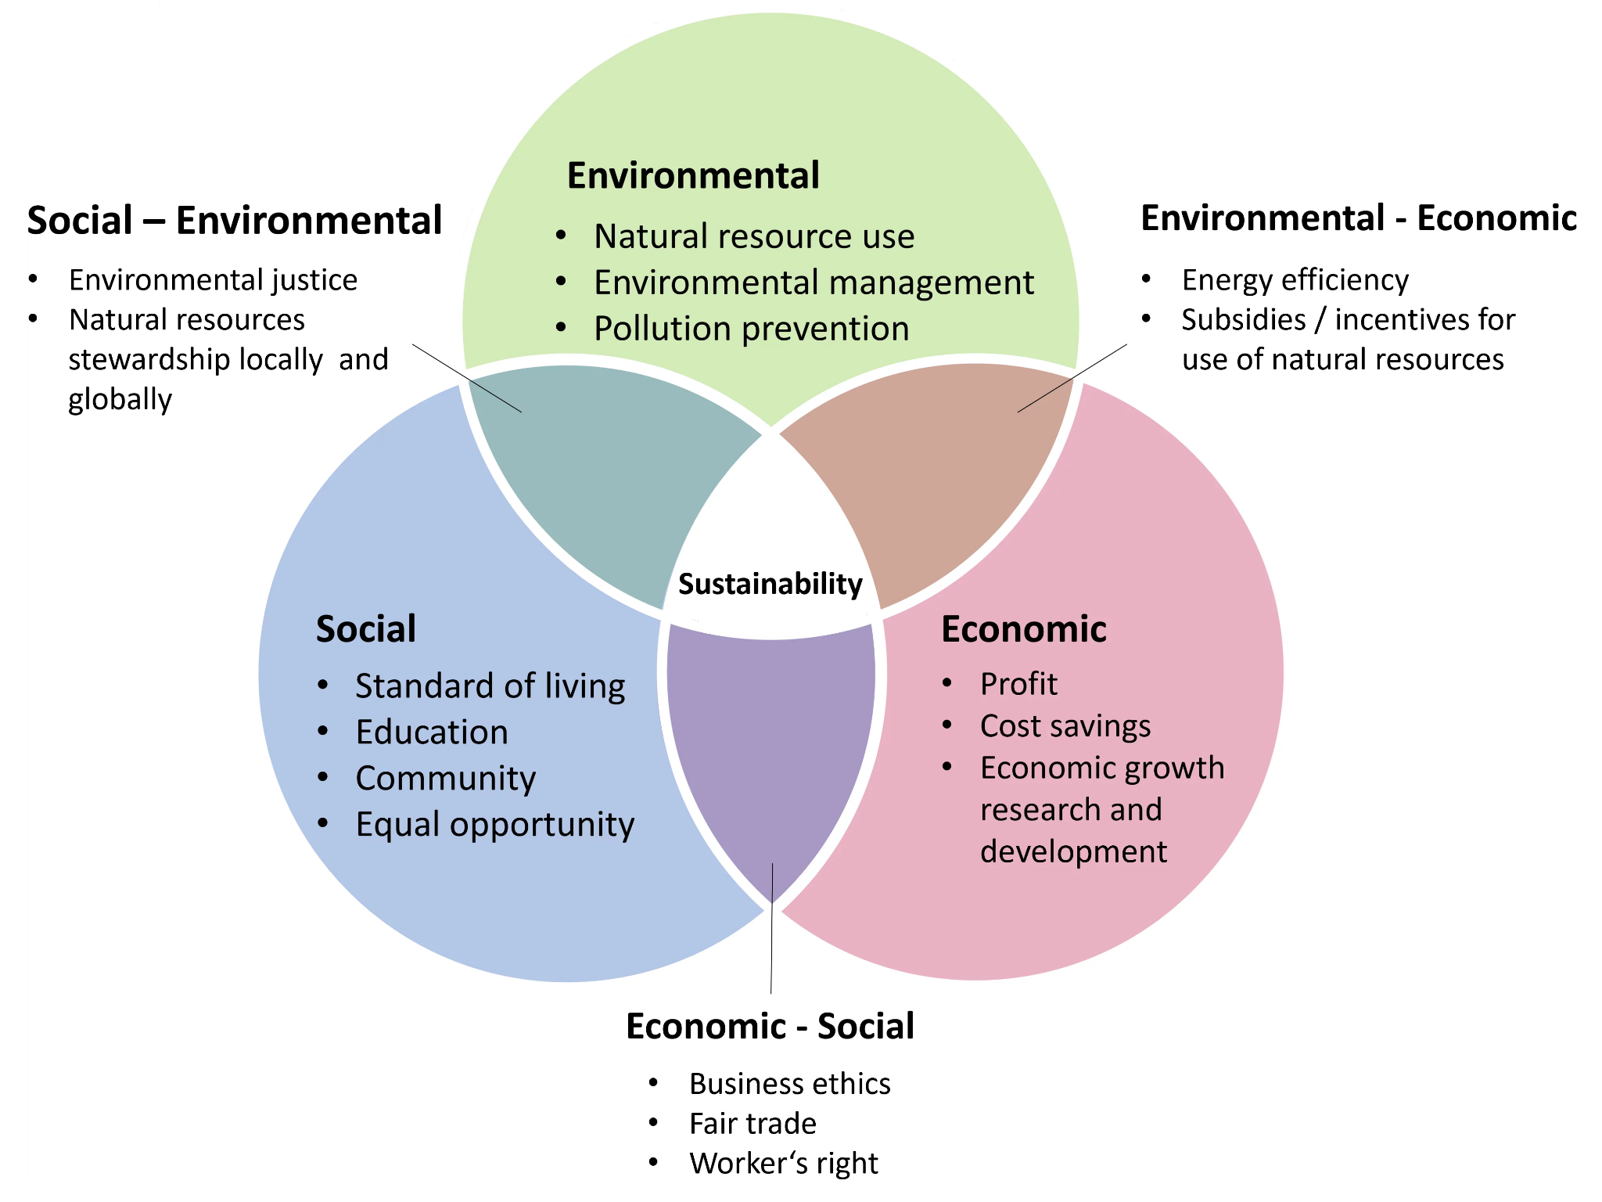

Slide 13
COVID and the SDG
Go through and read the recent SDG update from the UN. How has covid impacted the SDG? Write down a few key takeaways.
Copyright Bananaomics

Slide 14
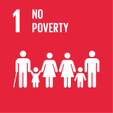
Sustainability and Poverty
(HL ONLY)
Copyright Bananaomics

Slide 15
During the video, ask yourself what is the relationship between sustainability and poverty?
Nigeria becomes major transit hub for illegal pangolin trade to Asia
South China Morning Post
Copyright Bananaomics

Slide 16
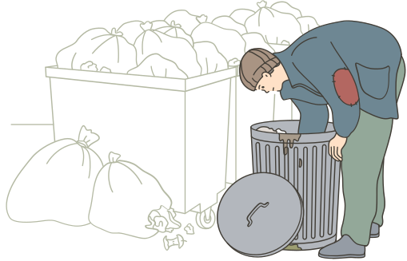
Poverty and Sustainability
Poverty creates an unsustainable relationship between people and natural resources. Typical unsustainable practices are deforestation, overhunting, land degradation, or pollution (specifically plastic pollution).
People that deal with poverty are more concerned with food, water, and shelter rather than sustainable practices.
Copyright Bananaomics

Slide 17
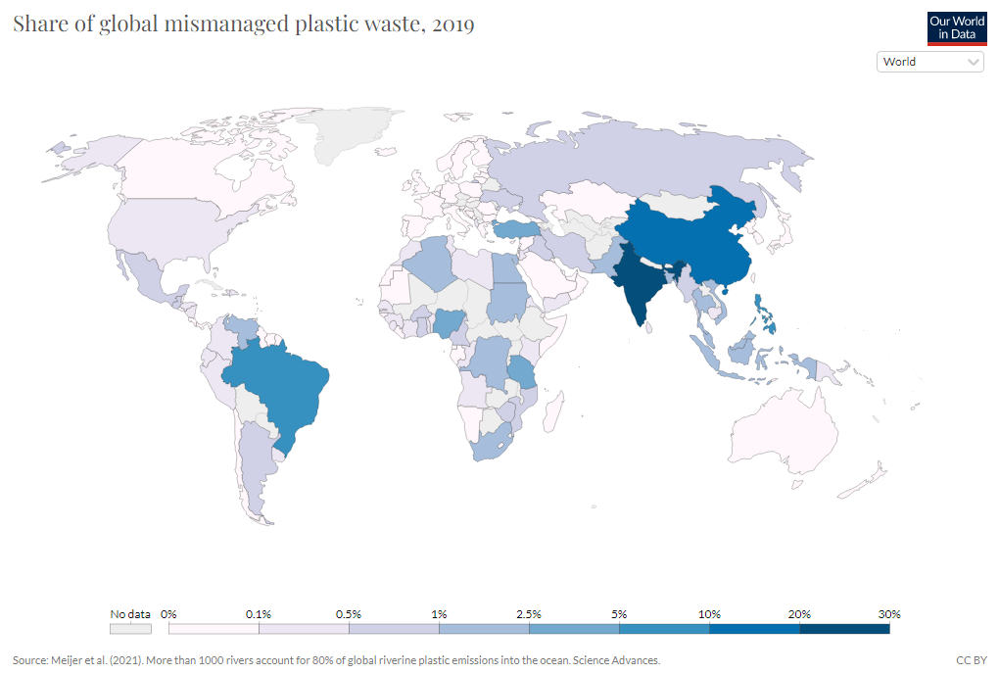
Global Mismanaged Plastic Waste
Copyright Bananaomics

Slide 18
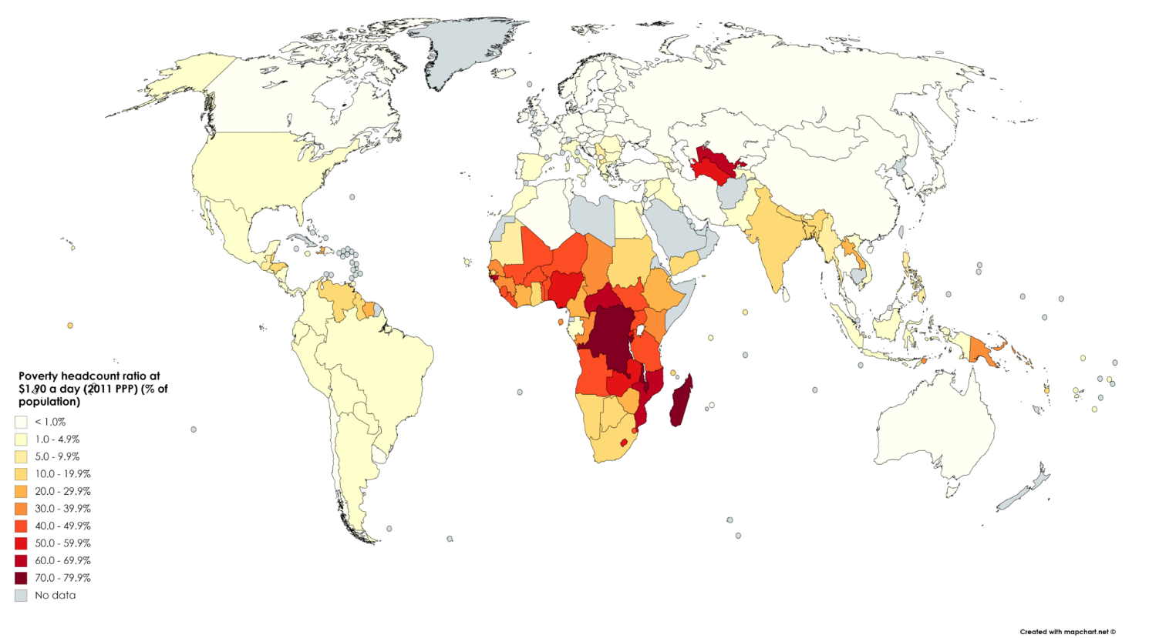
Poverty and Sustainability
Unsustainable development affects the poor the most.
Many of the poorest areas in the world live in vulnerable environments such as low coastal areas, floodplains, rainforests, etc. As climate change continues, these populations are more vulnerable to floods, monsoons, typhoons/hurricanes, etc.
Copyright Bananaomics

Slide 19
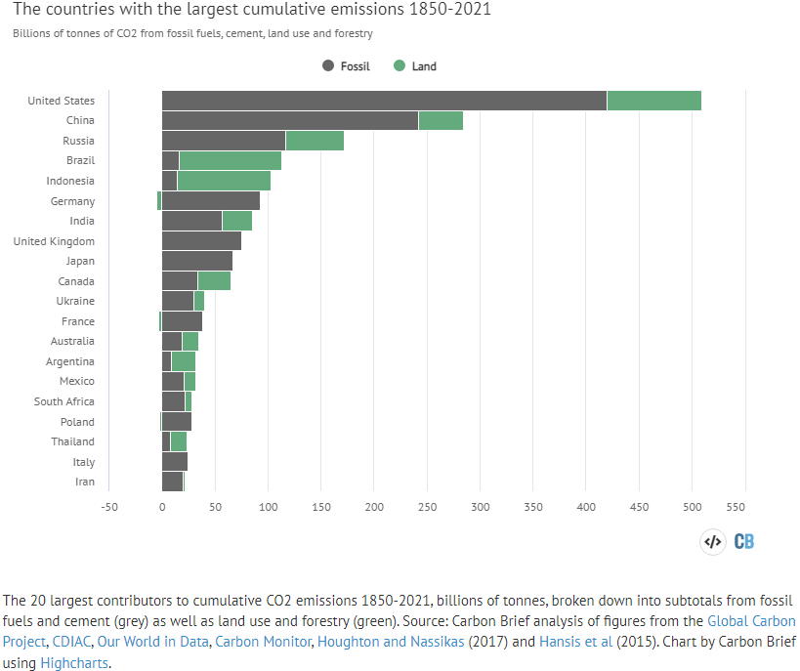
Poverty and Sustainability
Developed countries must make changes to reduce carbon emissions and natural resource reliance so the poorest countries can develop.
Copyright Bananaomics

Slide 20
Practice Question
Copyright Bananaomics

Slide 21
Paper 2
M13/3/ECONO/SL2/ENG/TZ0/XX
Copyright Bananaomics

Slide 22
Enjoying The Content?
Visit bananaomics.com to purchase package deals with discount prices!
BANANAOMICS

